Slide 1
Rabies
Dr Priyantha Perera

Slide 2
Epidemiology
Most feared zoonosis
Transmitted by mammals
NZ, Australia, UK are free from rabies
In Sri Lanka dog bites is the commonest cause
Still a public health concern in Sri Lanka due to increased stray dog population
Being an island we have good chance to eradicate rabies

Slide 3
Pathogenesis
Following an infective bite virus get attached to exposed nerves
Anterograde migration of virus towards brain
Virus multiply in brain and salivary gland
Virus cause dirrect destruction of neurons
Results in intracellular inclusion bodies ( Negri bodies).

Slide 4
Exposure category
Touching or feeding suspected animals, but clearly no contact with saliva and individuals skin undamaged prior or during contact is category 1
These individuals does not need tratment, but if in doubt can be given ARV

Slide 5
Minor exposures (category 2)
Animal has nibbled or licked exposed skin
Contact with saliva
Superficial non- bleeding scratches ( other than in head, neck, shoulder arms and hands

Slide 6
Major exposures (category 3)
All bites
Bleeding scratches
Scraches in heade, neck, shoulder, arms and hands
Mucus membrane contact with saliva

Slide 7
Clinical features
IP can be as short as 10 days or prolonged as 7 years
But usualy 1 – 3 months
IP depends on the exposure
Major exposures have a shorter IP
IP is shorter in children

Slide 8
Clinical features
Prodromal period lasting 2 – 7 days
Indefinite sensory changes may be felt at the bite site
Low grade fever, malaise, headache, sore throat may occur at this stage
Paresis and paralysis follows
Muscle of deglution are involved and swallowing become painful

Slide 9
Clinical Features
Any attempt to swallow will result in painful spasms of muscles of deglutition
This how the term Hydrophobia arise
Increasing depression and anxiety become apparent and patient become withdrawn.
Fan sign
Stage of excitement (furious Rabies) will follow with alternative periods of manic and calm

Slide 10
Clinical features
Spasms in throat become violent patient will look fearful
Cranial nerve palsies occur
Death occurs by respiratory failure or cardiac arrest

Slide 11
Diagnosis
Viral isolation from saliva, CSF
Serology
Demonstrating Negri bodies in brain of suspected animal
Postmortem brain biopsy

Slide 12
management
Mainly symptomatic
No specific treatment
Prevention of better than NO CURE

Slide 13
Differential diagnosis
Tetanus
Encephalitis
Hysteria
Bulbar polio

Slide 14
Prevention
Wash the wound thoroughly with soap and water
After soap is washed off apply 0.1% or 40- 70 % Isopropyl alcohol or tincture of Iodine
In cases of major exposure give both ARS and ARV
For minor exposures only ARV

Slide 15
Prevention
DO NOT SUTURE THE WOUND UNTILL ARS IS INFILTRATED

Slide 16
ARS
Human and equine
Human 20 IU/Kg, Equine 40 IU/Kg
No ST for human ARS
Infiltrate as much as possible beneath and around the wound and remaining ARS given IM, remotely as possible from ARV site, preferably in gluteal muscle
Should be given within 7 days of commencing ARV

Slide 17
ARV
Goat brain – not used now
Chick embryo- mostly used in government hospitals
Vero cell
Human diploid cell.
Given ID or Im

Slide 18
ARV schedule
If given IM dose is 1 ml
If given ID dose 0.1 ml/site
According to manufacturer ARV is given on day 0, 3, 7, 14, 30. In government hospitals only 0, 3, 7 and 30 given
If animal is alive can omit day 30 dose
IM given to deltoids in older children, for small children antero-lateral thigh

Slide 19
ARV schedule
Intradermaly is usually two sites in upper arm
Four site schedule which includes legs are used in late presentations and when patient is having reactions to equine ARS and human ARs is not available

Slide 20
Pre exposure vaccination
Not recommended for travelers to endemic areas
Given to people who work with animals and lab staff involved in handling virus

Slide 21
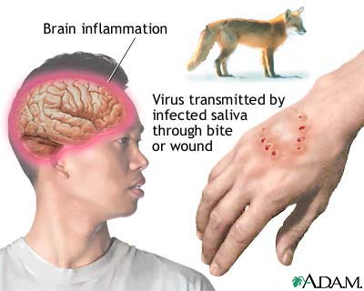

Slide 22
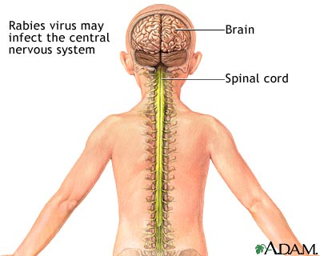

Slide 23
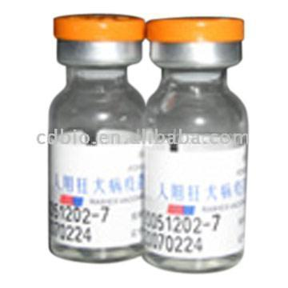

Slide 24
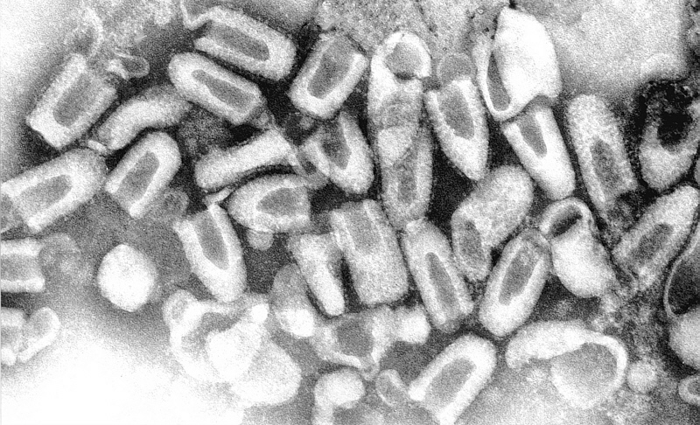

Slide 25
